Slide 1

NGO-ISAC
Multi Factor Authentication Advice
https://www.ngoisac.org/ membership@ngoisac.org

Slide 2
MFA Advice
In this mission, we provide guidance on Two-Factor Authentication (2FA) and explores the implementation of 2FA:
Strengthen account security
Protect against unauthorized access
Provide recommendations on suitable authentication methods

Slide 3

Authentication Factors
Something you know
Something you have
Something you are

Slide 4
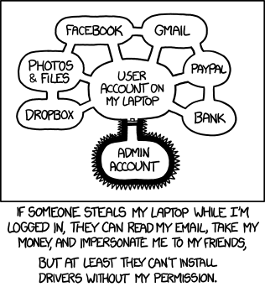
Definitions
Authentication – process where a user verifies who they are
Authorization – process of giving user permission to access resource
Account Recovery – process where a user gains access when credentials are lost
MFA – (Multi Factor Authentication) a process where users authenticate to a system with at least two credentials
2FA/FIDO/U2F – synonyms for MFA
Backup Codes – one-time use passwords for when MFA token is lost
https://www.explainxkcd.com/wiki/index.php/1200:_Authorization

Slide 5
Related Missions
Assets Inventory Development- The purpose of this mission is to assist the NGO in developing an inventory of their assets. This includes identifying and documenting all the hardware, software, and digital resources used within the organization. Having a comprehensive inventory helps in understanding the organization's technology landscape, identifying potential vulnerabilities, and implementing appropriate security measures. The support and advice provided by the Builder focuses on equipping the NGO with a structured process for asset inventory management.
Cloud Services mapping- In this mission, the Builders provide support in mapping the Beneficiary's cloud service providers. The objective is to gain visibility and understanding of the organization's cloud-based services, including Infrastructure-as-a-Service (IaaS), Platform-as-a-Service (PaaS), and Software-as-a-Service (SaaS). By mapping cloud services, the organization can better manage and secure their cloud-based assets and data.

Slide 6
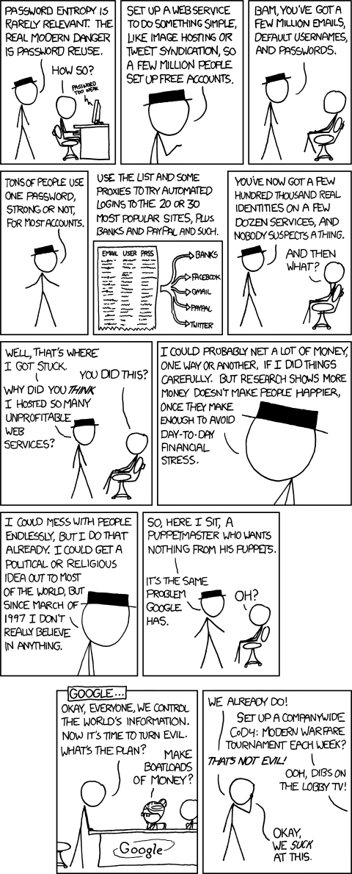
MFA Advice
Hackers are awash in passwords
MFA represent the strongest way to authenticate your account
MFA relies on something you know (the password) and something you have (the MFA token)
Password reuse is very common
Use a password manager!
https://www.explainxkcd.com/wiki/index.php/792:_Password_Reuse

Slide 7
MFA Advice
Hackers are awash in passwords
MFA represent the strongest way to authenticate your account
MFA relies on something you know (the password) and something you have (the MFA token)
Password reuse is very common
Use a password manager!
https://www.explainxkcd.com/wiki/index.php/792:_Password_Reuse

Slide 8
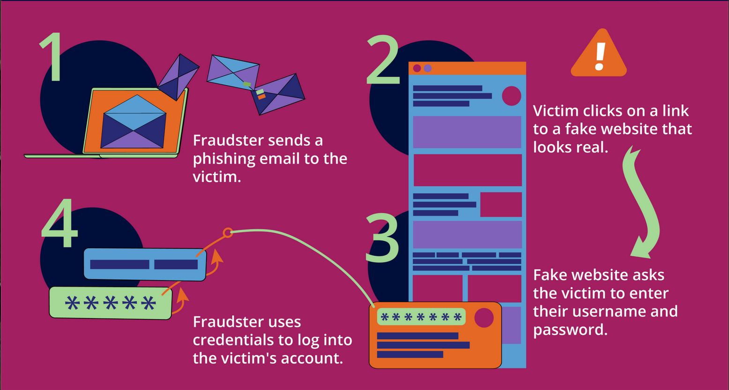
Account Take-Over / Account Recovery
MFA prevents Account Take-Over (ATO)
Account Recovery is the other other method to ATO
Most rely on email, phone, or credit card access to verify identity
Losing control of any of those could allow an attacker to attempt ATO
https://feedzai.com/blog/the-comprehensive-guide-to-account-takeover-fraud-prevention-and-detection/

Slide 9
What are we protecting against
Account Take-Over / Account Recovery
MFA prevents Account Take-Ovr (ATO)
Account Recovery is the other other method to ATO
Most rely on email, phone, or credit card access to verify identity
Losing control of any of those could allow an attacker to attempt ATO
EvilNginx
https://feedzai.com/blog/the-comprehensive-guide-to-account-takeover-fraud-prevention-and-detection/

Slide 10
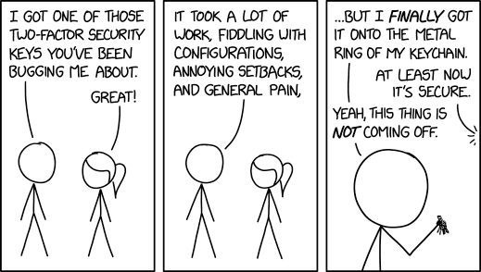
MFA methods
There are currently 4 major ways to accomplish MFA (least to most strong)
Email/SMS/Voice One-Time Passwords
Time based One-Time Passwords (TOTP) via an app
Universal 2nd Factor (U2F) via hardware devices
Passkeys – via Webauthn using your mobile device and authentication provider
Notes:
There are drawbacks to all methods. But a fact is that to be secure is to be annoyed

Slide 11
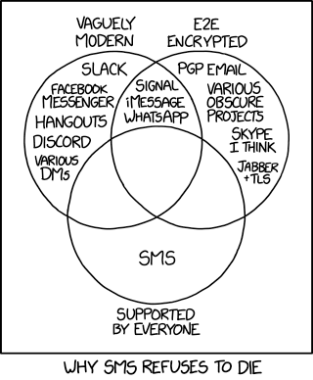
SMS / Email / Voice One-Time Passwords
OTP codes sent via text or email
Easy to deploy to users
Widely implemented https://2fa.directory/us/
Notes:
There are drawbacks to all methods. But a fact is that to be secure is to be annoyed

Slide 12
SMS / Email / Voice OTP trouble
Problems
Not very secure for motivated attacker
Better than nothing, but becuase of acknowledged weaknesses any company exclusively using sms/email OTP is suspect
SIM swap scams—in which an attacker fraudulently transfers a victim's phone number to their own SIM card,
Notes:
There are drawbacks to all methods. But a fact is that to be secure is to be annoyed

Slide 13
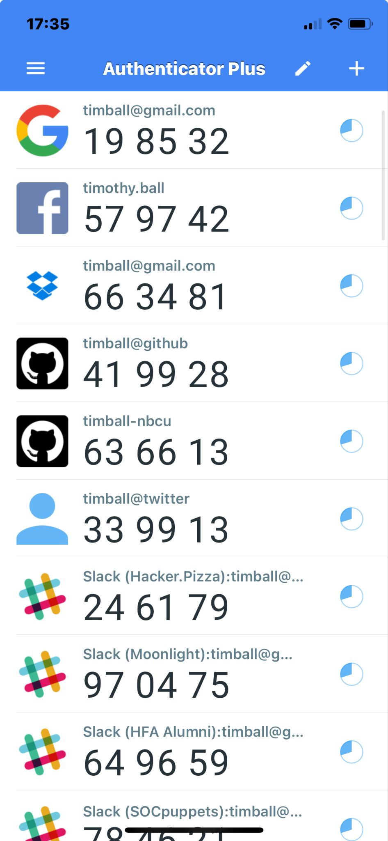
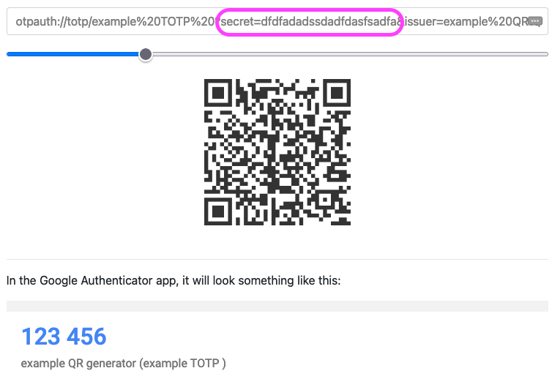
Time based One-Time Passwords Apps
Typically app based but can be done via your password manager
Scan a QR code or enter code
Widely implemented https://2fa.directory/us/
Notes:
Problems: must have device and device must be functional (batteries, screen working, app not corrupt) “Time-based one-time password (TOTP) is a computer algorithm that generates a one-time password (OTP) using the current time as a source of uniqueness. As an extension of the HMAC-based one-time password algorithm (HOTP), it has been adopted as Internet Engineering Task Force (IETF) standard RFC 6238.^{[1]}”

Slide 14
Time based One-Time Password Apps ( trouble)
“Time-based one-time password (TOTP) is a computer algorithm that generates a one-time password (OTP) using the current time as a source of uniqueness. As an extension of the HMAC-based one-time password algorithm (HOTP), it has been adopted as Internet Engineering Task Force (IETF) standard RFC 6238.^{[1]}”
Problems
Device must be functional and available
Too many TOTP apps (you likely only need one)
Lost device recovery is tricky
Notes:
Problems: must have device and device must be functional (batteries, screen working, app not corrupt)

Slide 15
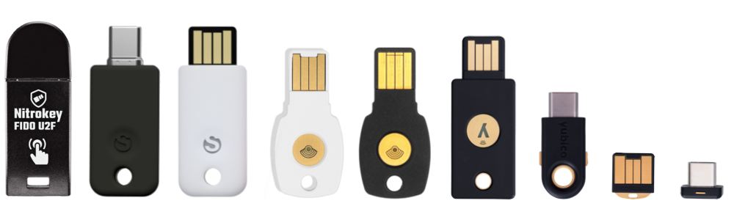
Universal 2 Factor hardware tokens
“Universal 2nd Factor (U2F) is an open standard that strengthens and simplifies two-factor authentication (2FA) using specialized Universal Serial Bus (USB) or near-field communication (NFC) devices based on similar security technology found in smart cards.^{[1][2][3][4][5]} It is succeeded by the FIDO2 Project, which includes the W3C Web Authentication (WebAuthn) standard and the FIDO Alliance's Client to Authenticator Protocol 2 (CTAP2).^{[6]}”
Typically usb based hardware device
Some keys have wireless NFC ability
Less widely implemented https://www.dongleauth.com/
YubiCo Secure it Forward free keys for many NGOs and CSOs
Notes:
Problems: Dongle hell

Slide 16
Universal 2 Factor hardware token trouble
Problems
Key must work with computer/phone
Needs a usb port
Or NFC reader
Key can be lost or Damaged
Have backup tokens for critical applications
Notes:
Problems: Dongle hell

Slide 17
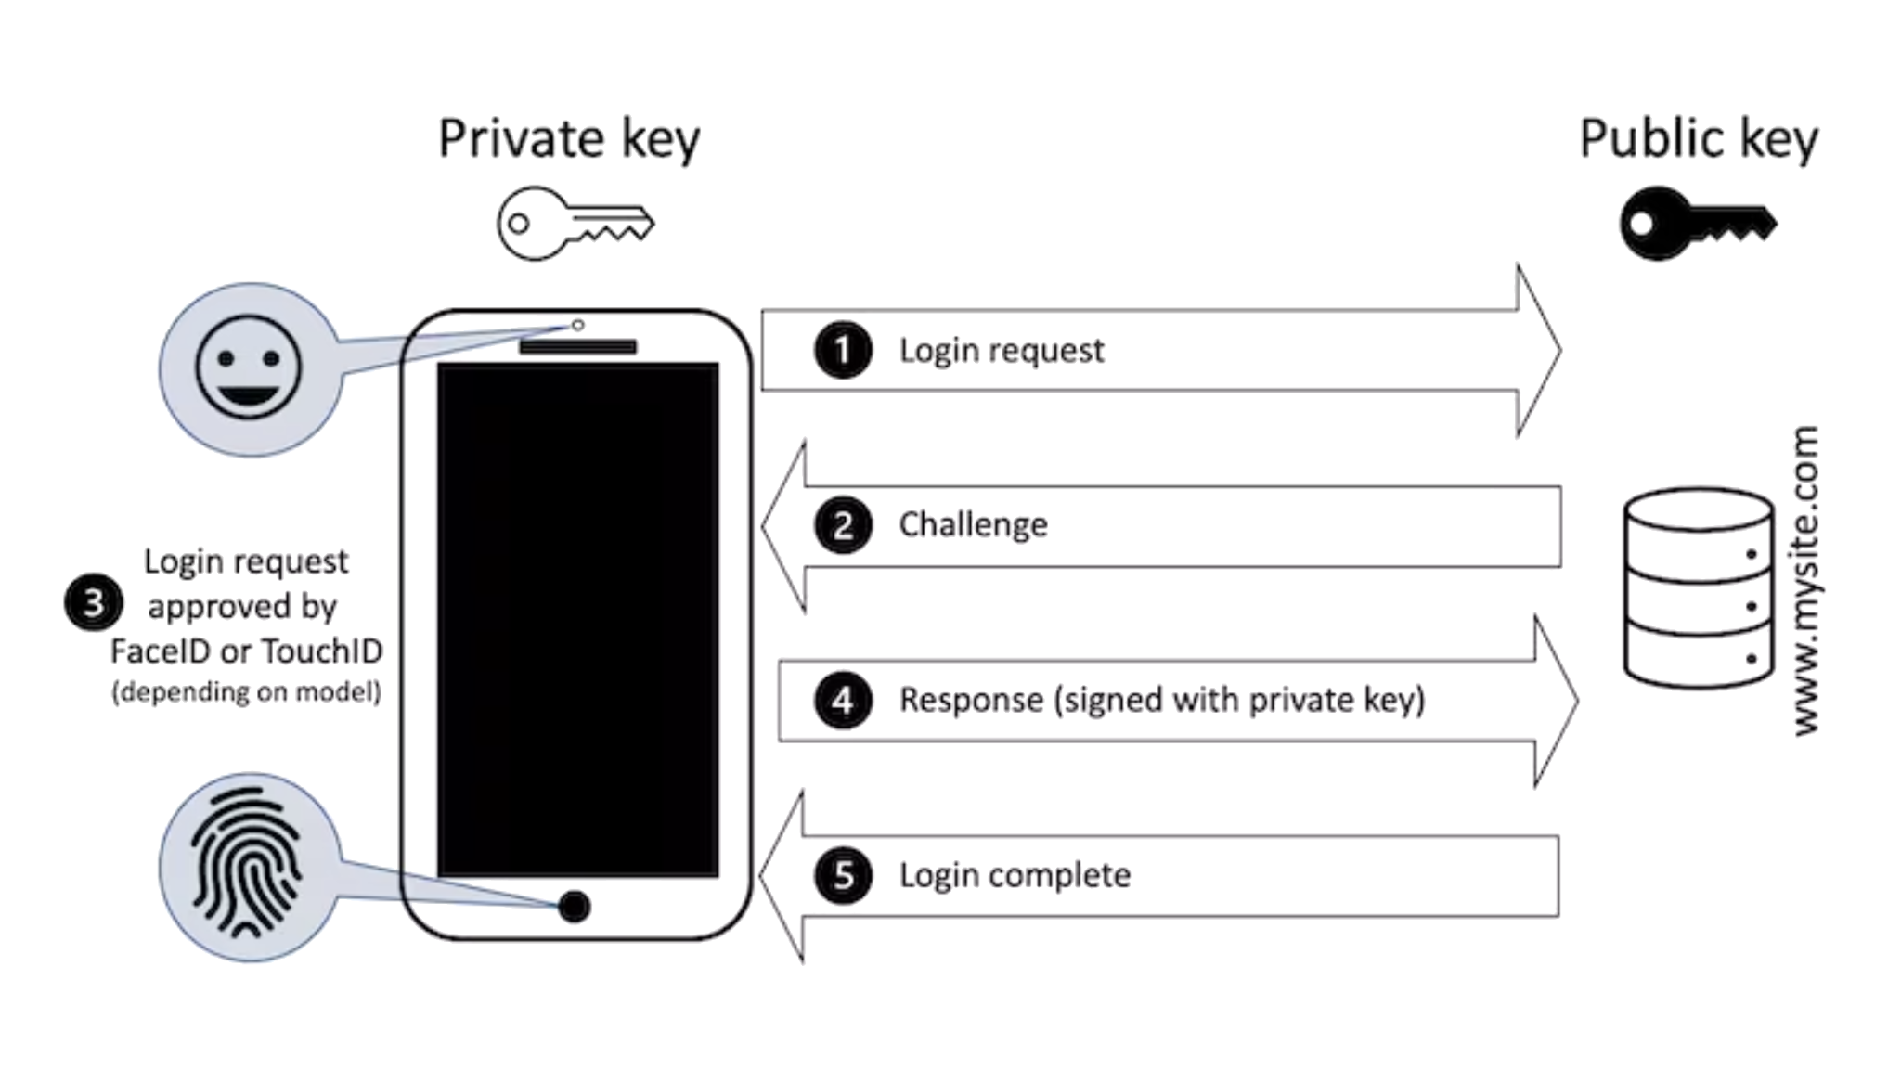
Passkeys / WebAuthn
“Web Authentication (WebAuthn) is a web standard published by the World Wide Web Consortium (W3C).^{[1][2][3]} WebAuthn is a core component of the FIDO2 Project under the guidance of the FIDO Alliance.^{[4]} The goal of the project is to standardize an interface for authenticating users to web-based applications and services using public-key cryptography. WebAuthn credentials (which are themselves FIDO credentials) are sometimes referred to as passkeys.^{[5]}”
Alternative to passwords
New protocol and support is growing https://passkeys.directory/
Google, Apple, Microsoft, Adobe, Meta, support
https://www.yubico.com/why-yubico/secure-it-forward/
Notes:
Problems: Dongle hell

Slide 18
Passkeys / WebAuthn trouble
Problems
Still relies on having access to mobile device for biometric authentication
Different fallback modes by vendor
Stacked complexity
Notes:
Problems: Dongle hell

Slide 19
Passkeys / WebAuthn
Notes:
Problems: Dongle hell

Slide 20
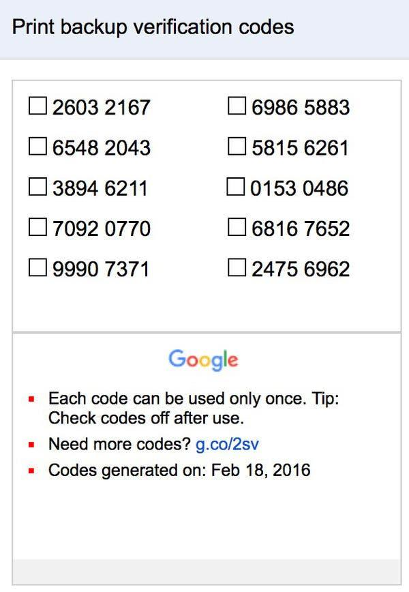
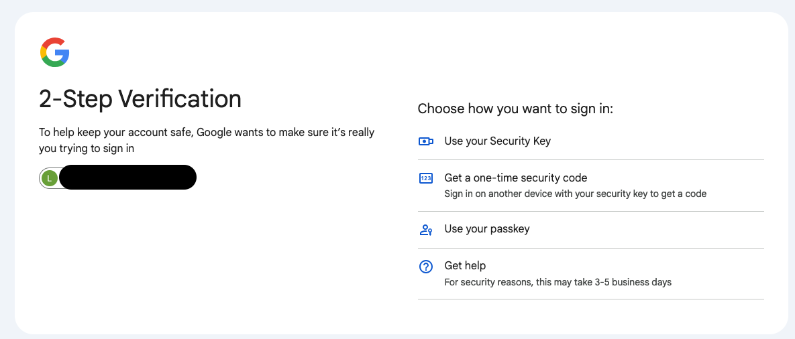
Problematic details
What do you do when your second factor fails you?
Backup codes
Alternative second factor methods

Slide 21
Steps to properly use MFA
Collect Account Info
1
How to MFA
Identify all accounts
Individually enable MFA on each account
Get backup codes
Verify functionality
4
2
Verify
Login and enroll MFA
3
Save Backup Codes
Notes:
Help users understand “how to find ALL accounts”

Slide 22
Enterprise rollout
Do company wide training
Define a rollout window
Communicate Communicate Communicate
Break up roll out into manageable groups
Location
Group
Avoid being overwhelmed
Thorough instructions
O365
Google Workspaces
AWS
Slack
Notes:
Also Gaming platforms …
And video/music streaming …
But really … everything

Slide 23
That’s a lot of work,
which accounts should I do first?
Mobile Device provider
Google/Android, Apple // passkey links
Computing Platforms
Microsoft, AWS, GCP, Azure, GoDaddy, Namecheap
Email provider
Google, Outlook, protonmail, Yahoo
Mobile phone provider
Verizon, t-mobile, AT&T, US Cellular, Mint
Banking / Finance
JPMorgan Chase, Bank of America, Wells Fargo, Citibank, PNC, Truist, Capital One, PayPal, Venmo, Zelle, ADP, Rippling, Gusto, Quickbooks,
Social Media
Facebook, Instagram, SnapChat, TikTok, YouTube, WhatsApp, LinkedIn
Shopping
Amazon, Walmart, Target
Notes:
Also Gaming platforms …
And video/music streaming …
But really … everything

Slide 24
[ Questions ? ]
Notes:
Be ready for: Constellation, Membership dues

Slide 25
Thank You
timball / CISO
timball@ngoisac.org https://www.ngoisac.org/
membership@ngoisac.org

